Slide 1
Data Binding
Data binding in detail
Two-way binding
Decisions and iteration
Additional techniques
Demo app: AngularDev/Demos/03-DataBinding/DemoApp
To install: npm install
To run: ng serve

Slide 2
Section 1: Data Binding in Detail
Example application
Recap of simple data binding syntax
Binding to computed values
Binding target properties
Binding events
Safe navigation

Slide 3
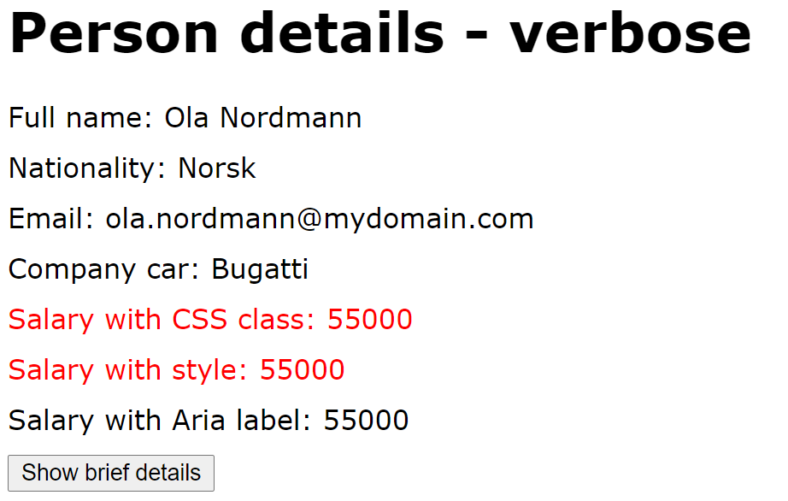
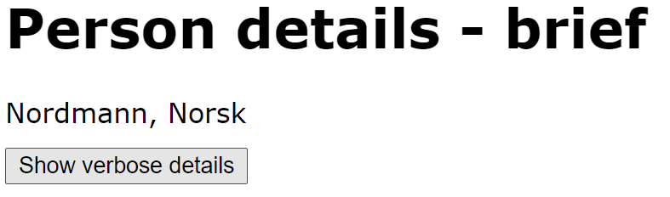
Example Application
In this section we dig deeper into data binding syntax
In the demo app, click the Data binding syntax link
Click the button to toggle between verbose / brief modes
Notice the button label changes when you click it
3

Slide 4
Recap of Simple Data Binding Syntax
Here's a recap of simple data binding using {{ }}
The expressions bind to these component properties:
<h1>Person details - verbose</h1>
<div>Full name: {{firstName}} {{lastName}} </div>
<div>Nationality: {{nationality}} </div>
<div>Email: {{emailAddress}} </div>
…
data-binding-syntax.component.html
@Component({…})
export class DataBindingSyntaxComponent {
firstName: string;
lastName: string;
nationality: string;
emailAddress: string;
…
}
data-binding-syntax.component.ts
4

Slide 5
Binding to Computed Values
You can bind to computed values within the {{ }}
E.g. call a function that returns a value dynamically
Template expressions shouldn't change any application state, except the value of the target property
<button (click)="onVerboseToggle($event)"> {{label()}} </button>
export class DataBindingSyntaxComponent {
…
label() {
return (this.verbose) ? 'Show brief details' : 'Show verbose details';
}
}
5

Slide 6
Binding Target Properties
You can bind target properties on an element
Enclose property name in []
<div [hidden]='!verbose'>
<h1>Person details - verbose</h1>
<div>Full name: {{firstName}} {{lastName}} </div>
<div>Nationality: {{nationality}} </div>
…
</div>
<div [hidden]='verbose'>
<h1>Person details - brief</h1>
<div>{{lastName}}, {{nationality}} </div>
</div>
export class DataBindingSyntaxComponent {
…
verbose: boolean;
}
6

Slide 7
Binding Events
You can bind an event to a function in the component
Enclose event name in ()
Call handler function, and pass argument(s) if you like
<button (click)="onVerboseToggle($event)"> {{label()}} </button>
export class DataBindingSyntaxComponent {
…
onVerboseToggle(event: any) {
this.verbose = !this.verbose;
}
}
7

Slide 8
Safe Navigation
The safe navigation operator ?. is very useful
Means the field is optional
If field is undefined, rest of expression is ignored
<div>Company car: {{companyCar?.make}}</div>
8

Slide 9
Section 2: Two-Way Data Binding
2-way data binding syntax
Delaying data binding until "done"
2-way data binding example
Supporting 2-way data binding

Slide 10
2-Way Data Binding Syntax
[()] syntax gives 2-way binding
Binds component model to UI, to display data
Binds UI to component, to update data in model
<input type='number' [(ngModel)]="salary">
10

Slide 11
Delaying Data Binding Until "Done"
Sometimes you want to delay updating the model value until the user has tabbed out of a text box
E.g. a numeric field, don’t update model after each digit
To achieve this, handle the blur or change events
Upon the event, update the model with the UI value
<input type='number' [value]="salary" (change)="onSalaryChange($event)">
export class DataBindingSyntaxComponent {
…
onSalaryChange($event) {
this.salary = Number($event.target.value);
}
}
11

Slide 12
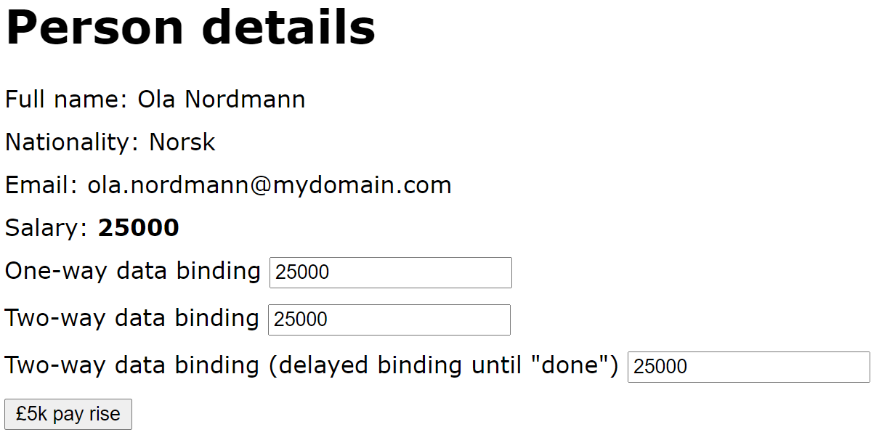
2-Way Data Binding Example (1 of 2)
Let's see an example of 2-way data binding
In the demo app, click the 2-way data binding link
There are two text boxes, where you can change salary
There's also a button, which gives a £5k pay rise
12

Slide 13
2-Way Data Binding Example (2 of 2)
Here are the relevant parts of the HTML and code:
Salary: <b> {{salary}} </b>
One-way data binding <input type='number' [value] = "salary">
Two-way data binding <input type='number' [(ngModel)] = "salary">
Two-way data binding (delayed binding until "done")
<input type='number' [value]="salary" (change)="onSalaryChange($event)">
<button (click)="payRise()">Pay rise</button>
two-way-binding.component.html
export class TwoWayBindingComponent {
salary: number;
…
payRise() {
this.salary = this.salary + 5000;
}
onSalaryChange($event) {
this.salary = Number($event.target.value);
}
two-way-binding.component.ts
13

Slide 14
Supporting 2-Way Data Binding (1 of 2)
Your app dependencies must specify Angular Forms
Angular CLI does this for you - see package.json
"dependencies": {
"@angular/forms": "^17.0.0",
…
}
package.json
14

Slide 15
Supporting 2-Way Data Binding (2 of 2)
Your component must import FormsModule:
import { FormsModule } from '@angular/forms';
…
@Component({
selector: 'app-two-way-binding',
standalone: true,
imports: [CommonModule, FormsModule],
templateUrl: './two-way-binding.component.html',
styleUrl: './two-way-binding.component.css'
})
export class TwoWayBindingComponent {…}
two-way-binding.component.ts
15

Slide 16
Section 3: Decisions and Iteration
Overview
If tests
If-then-else tests
For loops
Switches

Slide 17
Overview
Angular has structural directives that allow you to make decisions and to do iteration in your HTML template
ngIf - conditional rendering
ngFor - iterative rendering
ngSwitch - branch-based rendering
Aside:
In Angular terminology, a structural directive is a class that changes the DOM by adding/removing elements
17

Slide 18
If Tests (1 of 2)
You can use ngIf to perform a test
Use the ngIf directive, prefixed with *
Angular embeds content in an <ng-template> tag
Angular activates <ng-template> tag conditionally
<div *ngIf="salary > 40000" style="color:red">
[Upper tax payable on {{salary - 40000}}]
</div>
ng-if.component.html
18

Slide 19
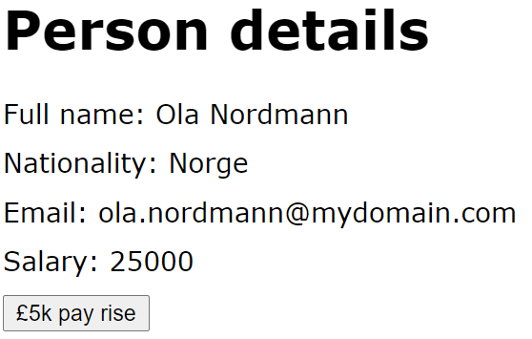
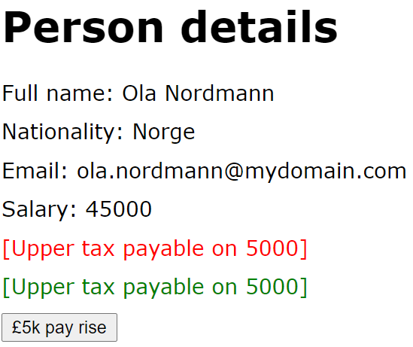
If Tests (2 of 2)
Let's see an example of ngIf tests
In the demo app, click the ngIf link
Initial display
After several pay rises
19

Slide 20
If-Then-Else Tests (1 of 3)
ngIf can specify a then clause
Lets you define the <ng-template> tag separately
Use # to give the <ng-template> tag a name
<div *ngIf="salary > 40000; then hiTaxTemplate1"></div>
<ng-template #hiTaxTemplate1> … </ng-template>
ng-if-then-else.component.html
20

Slide 21
If-Then-Else Tests (2 of 3)
ngIf can also specify an else clause
Specify names of true/false <ng-template> tags
<div *ngIf="salary > 40000; then hiTaxTemplate2 else loTaxTemplate"></div>
<ng-template #hiTaxTemplate2> … </ng-template>
<ng-template #loTaxTemplate> … </ng-template>
ng-if-then-else.component.html
21

Slide 22
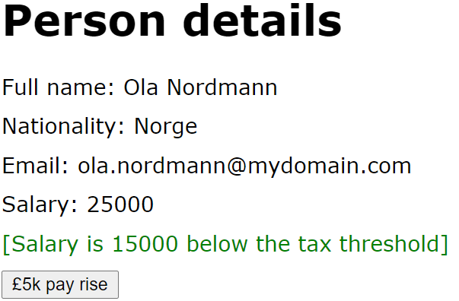
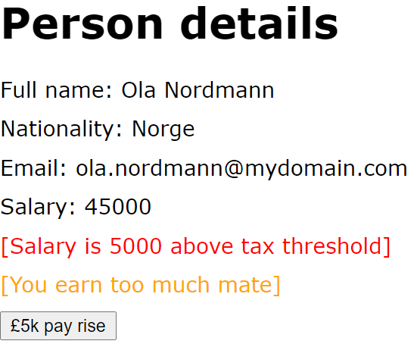
If-Then-Else Tests (3 of 3)
Let's see an example of if-then-else tests
In the demo app, click the ngIf-then-else link
Initial display
After several pay rises
22

Slide 23
For Loops (1 of 2)
You can use ngFor to iterate over a collection
Specify the collection you want to iterate over
Angular clones the element for each collection item
<ul>
<li *ngFor="let s of skills; let i=index">
[Skill {{i+1}}] {{s}}
</li>
</ul>
ngFor exposes several useful variables:
index, first, last, even, odd
ng-for.component.ts
23

Slide 24
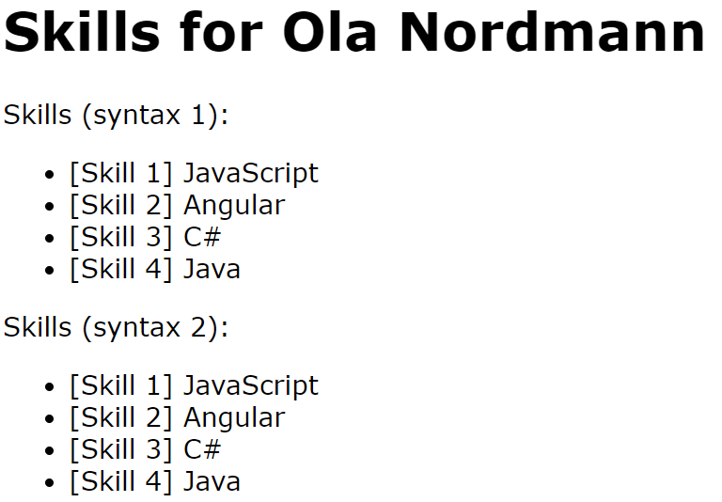
For Loops (2 of 2)
Let's see an example of ngFor loops
In the demo app, click the ngFor link
24

Slide 25
Switches (1 of 2)
You can use ngSwitch for multi-way branching
Use ngSwitchCase for each branch
Use ngSwitchDefault for default branch (optional)
<span [ngSwitch]="nationality">
<span *ngSwitchCase="'Norge'">Norway</span>
<span *ngSwitchCase="'UK'">UK</span>
<span *ngSwitchDefault>[Other country]</span>
</span>
ng-switch.component.ts
25

Slide 26
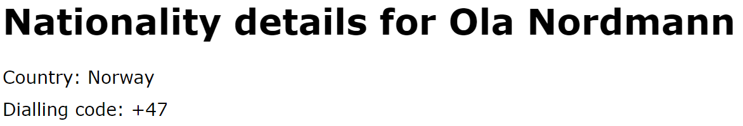
Switches (2 of 2)
Let's see an example of ngSwitch branching
In the demo app, click the ngSwitch link
26

Slide 27
Summary
Data binding in detail
Two-way binding
Decisions and iteration

Slide 28
Annex: Additional Techniques
Data binding CSS classes and styles
Key binding and template variables

Slide 29
Data Binding CSS Classes and Styles
You can data bind a CSS class
Set [class.aClass] to a binding expression
If binding expression is truthy, CSS class is applied
You can data bind a CSS style
Set [style.aStyle] to a binding expression
The binding expression specifies the style value
<div [class.emphasis]="salary >= 40000">Salary {{salary}}</div>
<div [style.color]="salary >= 40000 ? 'red': 'green'">Salary {{salary}}</div>
29

Slide 30
Key Binding and Template Variables
Key binding
The keyup event ordinarily triggers on every keystroke
You can use the keyup.enter pseudo-event to target just the Enter keystroke
Template variables
You can declare a template variable to represent an element, via the syntax "#templateVarName"
Allows you to access the element easily elsewhere
30

Slide 31
Key Binding and Template Variables
In the demo app, click the Additional techniques link
Here's the relevant HTML and code
<h1>Skills for {{name}}</h1>
<input #newSkill (keyup.enter)="addSkill(newSkill)">
<button (click)="addSkill(newSkill)">Add</button>
<p>{{skills}}</p>
additional-techniques.component.html
export class AdditionalTechniquesComponent {
name = "Kari Nordmann";
skills = "";
addSkill(newSkill: HTMLInputElement) {
this.skills += newSkill.value + " ";
newSkill.value = "";
newSkill.focus();
}
}
additional-techniques.component.ts
31

